Slide 1

Methane – Carbon Dioxide Interaction: A Classical Molecular Dynamics Study
by Subrata Haldar under the supervision of Dr. M. K. Panigrahi
Indian Institute of Technology Kharagpur

Slide 2
Introduction
Notes:
Topic -> research questions -> importance of study -> objectives

Slide 3
About the study
CH₄ and CO₂ are two of the most important greenhouse gases accounting for up to 35% of Earth’s greenhouse effect. Other than this, they’re also involved in several important geological processes like hydrocarbon formation, melting of glaciers, etc.
This study was an attempt to simulate CH₄ and CO₂ interaction (greenhouse gases), using classical molecular dynamics, at high PT conditions.
To account for the variation in concentrations of above gases in nature, several different concentrations have been used to simulate the binary gas mixture (X_{CH4} = 0.1, 0.3, 0.5, 0.7, 0.9)
Open-source MD package LAMMPS (Large-Scale Atomic/Molecular Massively Parallel Simulator) was used for performing the simulations
Open-source molecule builder and visualizer Avogadro was used to generate CH₄ and CO₂ molecules
Open-source packing configurator Packmol was used to generate the system of molecules
Open-source modelling and visualization software VMD (Visual Molecular Dynamics) was used for data visualization and analysis

Slide 4
Objective of the study
The questions this study tries to answer are:
Is there any change to the miscibility of CH₄ and CO₂ at high PT conditions?
Do the molecules of CH₄ and CO₂ show any layering/clustering at these PT conditions?
This study was conducted in an attempt to lay the foundation for future research on the interaction of greenhouse gases
It is important to understand the interaction of greenhouse gases like CH₄ and CO₂ because said gases aren’t necessarily undesirable; they have many uses other than their contribution to the greenhouse effect
Data obtained through this study can be used to conduct further analysis to determine the optimal methods of storing greenhouse gases, including subsurface storage

Slide 5
Definitions
Classical Molecular Dynamics: a tool used to study the effect of specific nanostructures on the overall mechanical behavior of a material. It solves Newtonian equations of motions for each atom in the system using initial coordinates, a potential, and algorithms for propagation. It also treats nuclei as point particles that follow classical Newtonian dynamics
NVE: The constant-energy, constant-volume ensemble (NVE), also known as the microcanonical ensemble, is obtained by solving Newton’s equation without any temperature and pressure control.
NPT: The constant-temperature, constant-pressure ensemble (NPT) is a statistical ensemble used to determine the equation of state of fluids. It allows control over both the temperature and pressure
RDF: Radial distribution function is a statistical measure used to predict the relative position of a specific pair of particles. It is also known as the radial probability distribution and depends upon the probability density and the volume of the shell

Slide 6
Methodology
Notes:
Quantitative study -> methodology flowchart -> simulation details -> data analysis

Slide 7
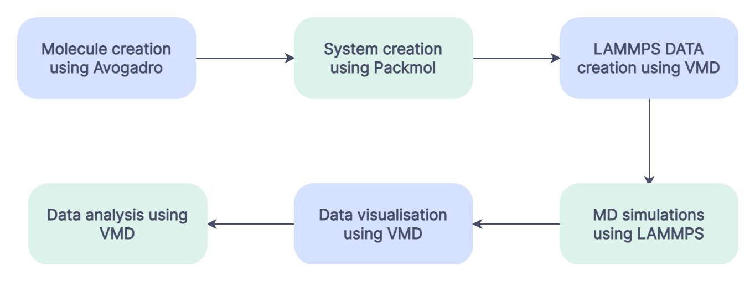
Methodology overview

Slide 8
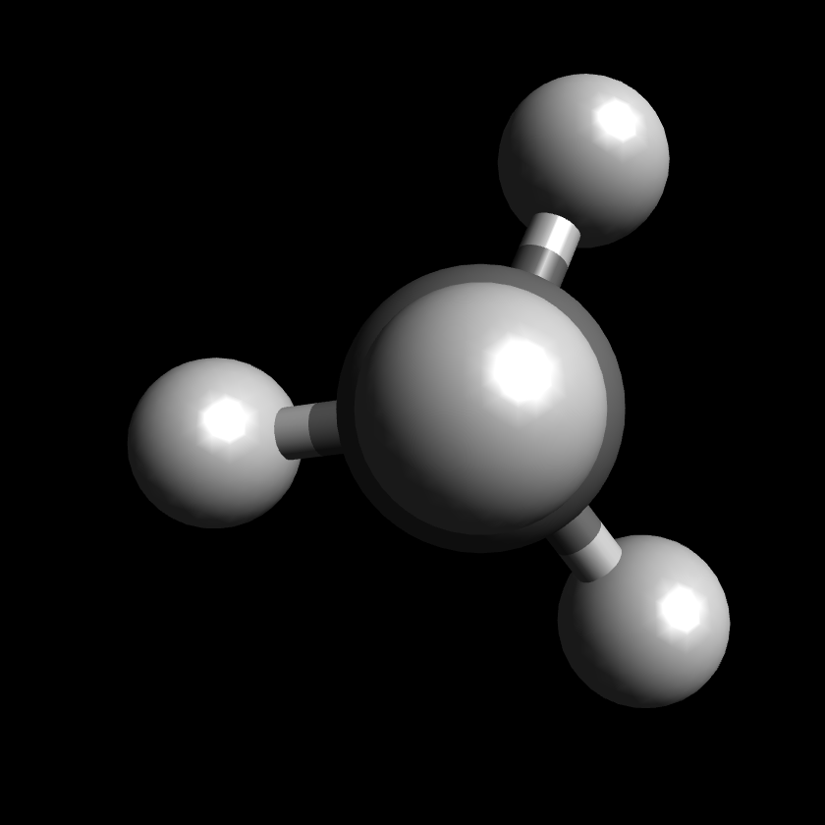
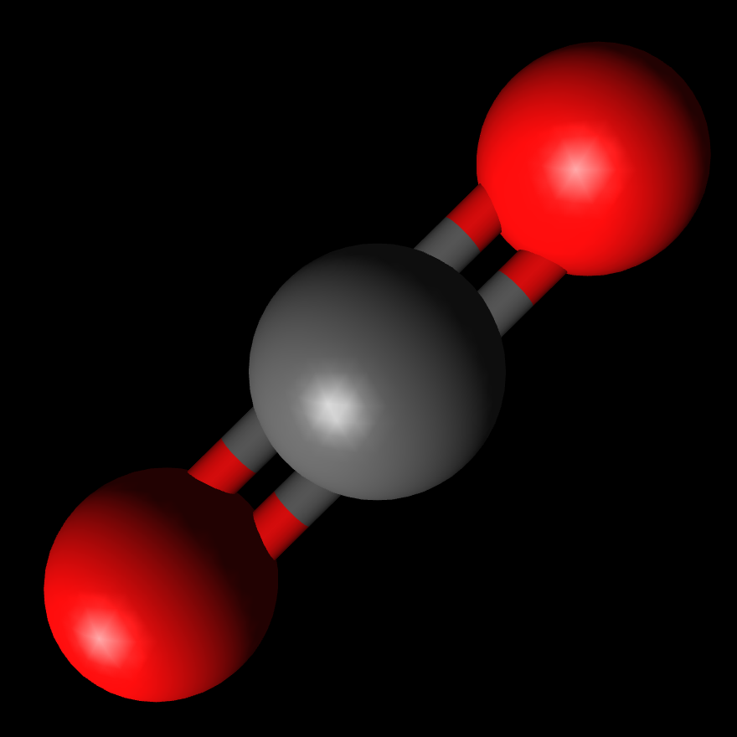
Molecule creation: Avogadro

Slide 9
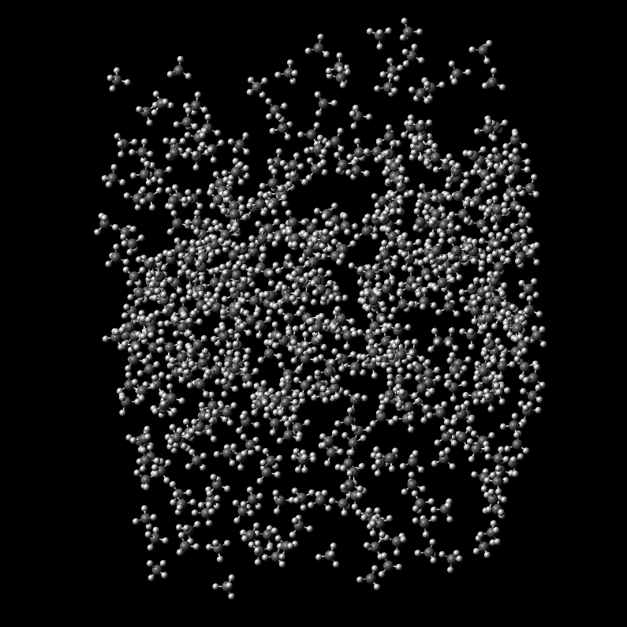
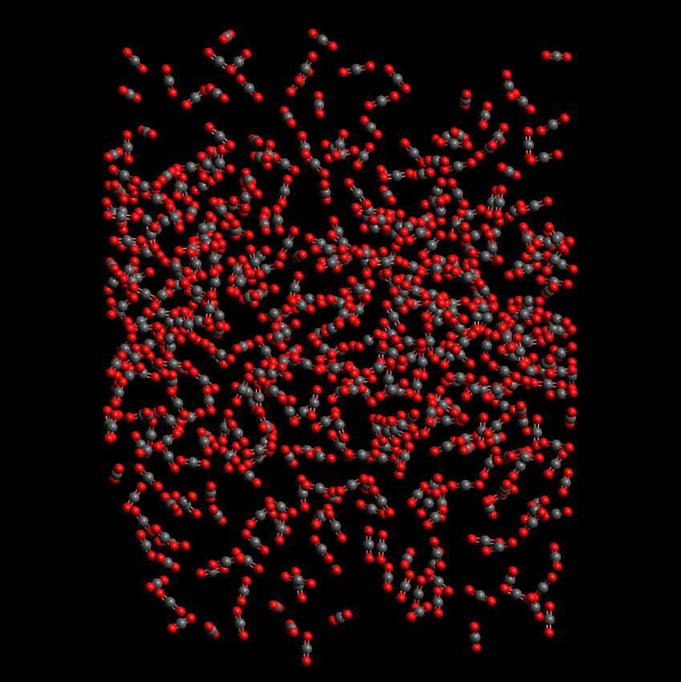
System creation: Packmol

Slide 10
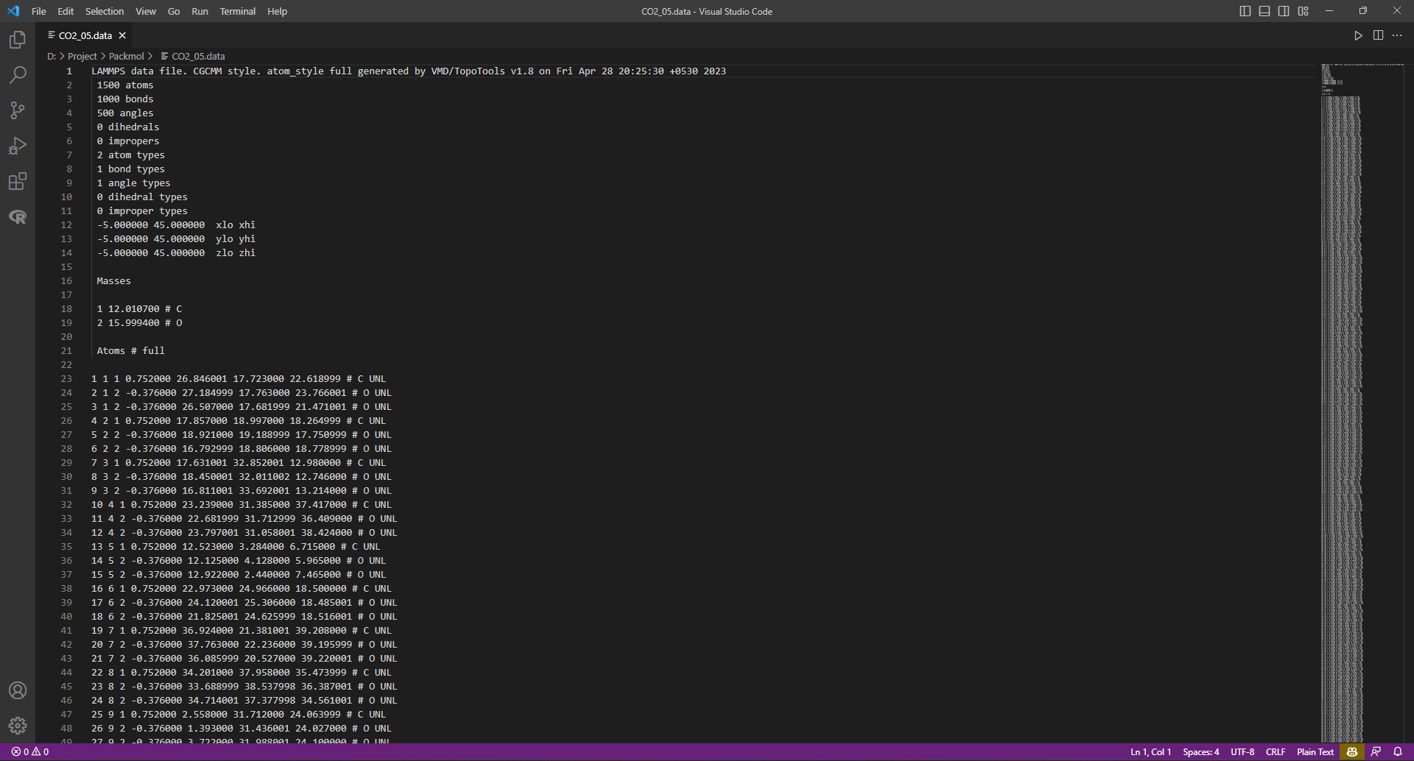
LAMMPS DATA: VMD

Slide 11
MD Simulations: LAMMPS
Defining system as a 50 Å x 50 Å x 50 Å box with periodic boundary conditions
Defining Lennard-Jones cutoff with long-range Coulombic interactions
Defining PPPM method to calculate implicit data for above selection
Defining pair, bond and angle parameters for simulation related calculations
30000 nve/limit runs: initial equilibration without explosion (microcanonical ensemble; provides PT conditions for next run)
50000 npt runs: 5000 atm & 600 K (isothermal-isobaric ensemble)
10000 nve runs: check for system equilibrium (provides PT conditions for next run)
50000 npt runs: 1000 atm & 600 K (at reduced pressure conditions)
10000 nve runs: final check for system equilibrium

Slide 12
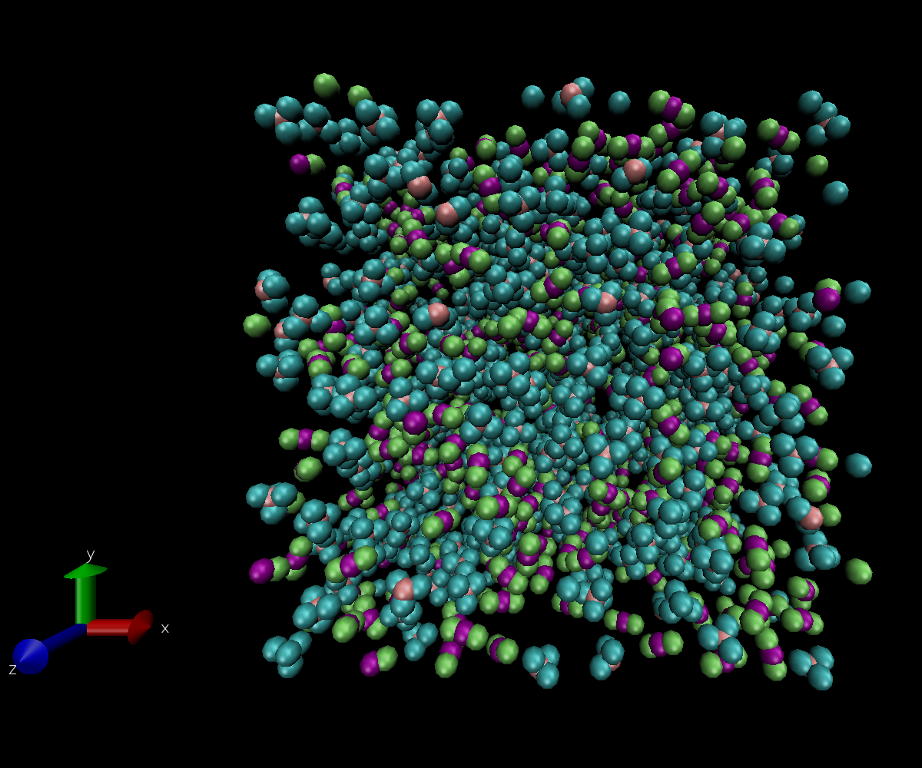
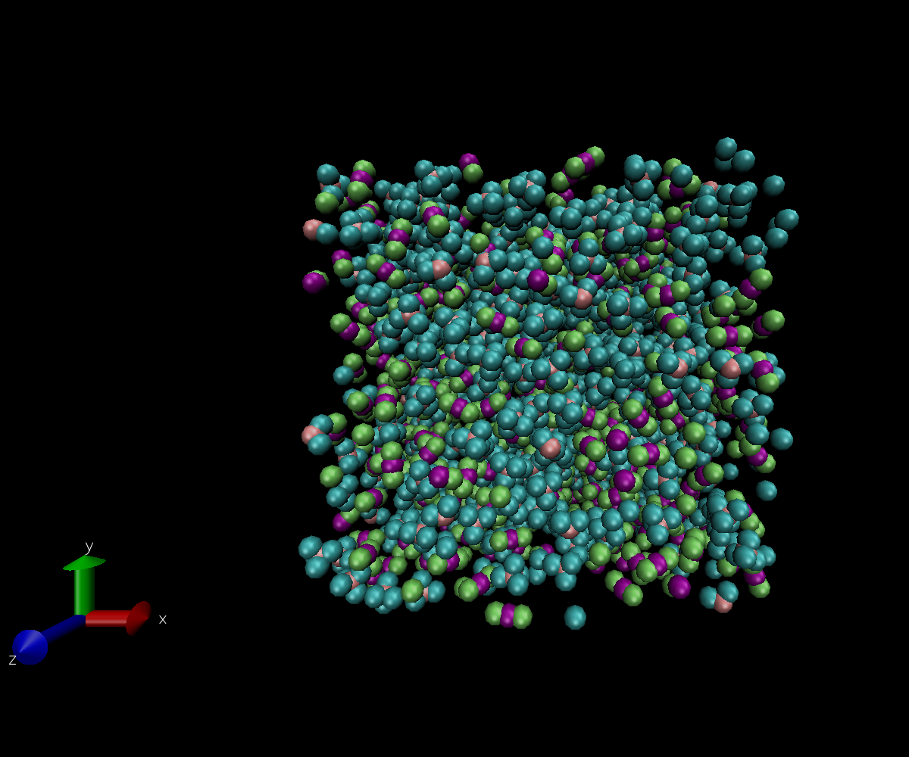
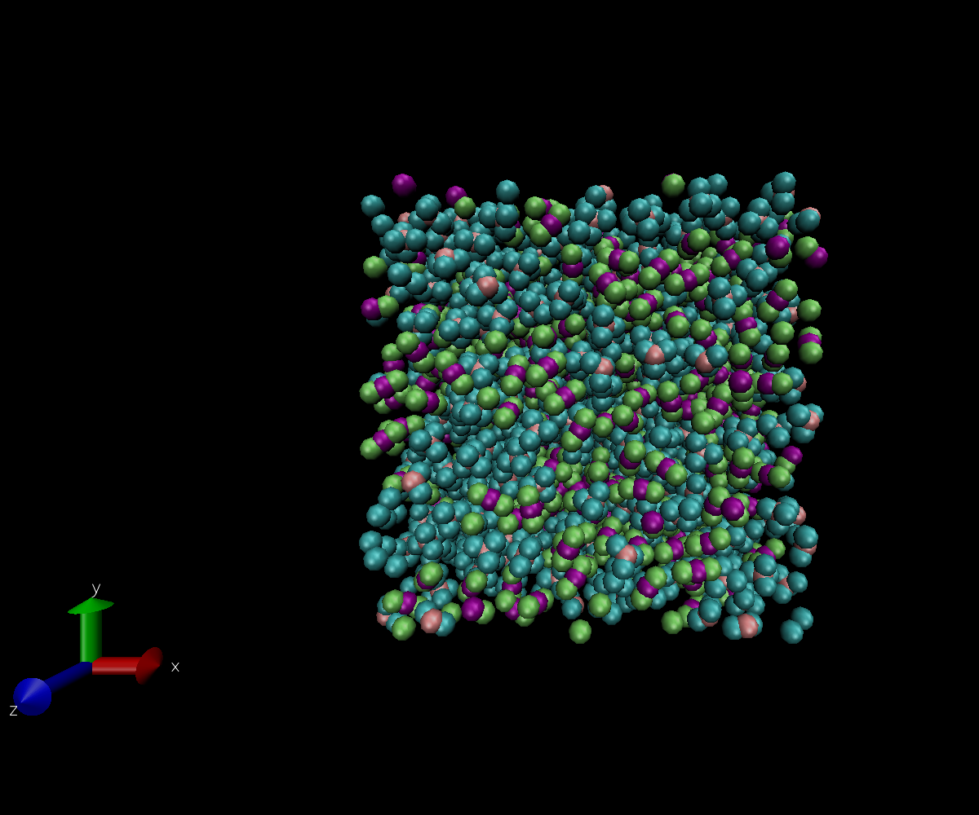
Data Visualization: VMD

Slide 13
DATA analysis: VMD & C++
VMD
LAMMPSTRJ (LAMMPS Trajectory) data dumped during simulations
LAMMPSTRJ data loaded into VMD to visualize movement of molecules
RDF g(r) generated between atom pairs using VMD data analysis tools
C++
a and b parameters/constants calculated for Reidlich-Kwong equation of state for all PT values
Cubic equation for molar volume V_{m} generated by entering all known parameters/constants in the Reidlich-Kwong equation of state
Cubic equation solved using Newton-Raphson method (in C++) to get value of V_{m}
True volume calculated using V_{m} and number of moles (to be used for calculating expected density)
Density calculated by dividing mass of system with volume of system (simulated and expected)

Slide 14
Results
Notes:
Data -> analysis results -> significant findings

Slide 15
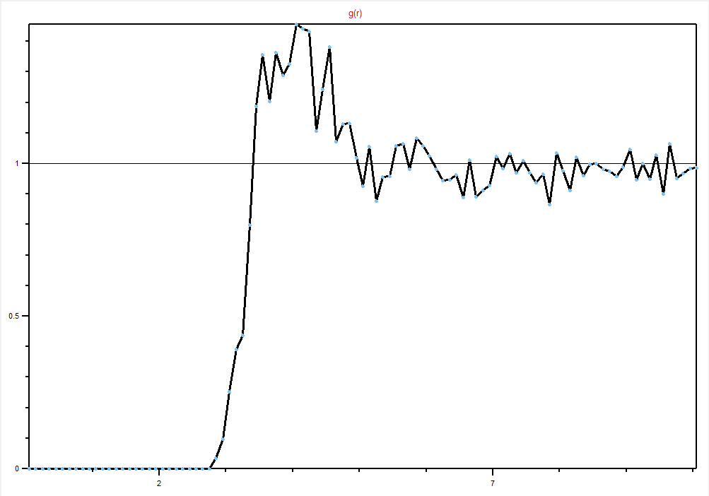
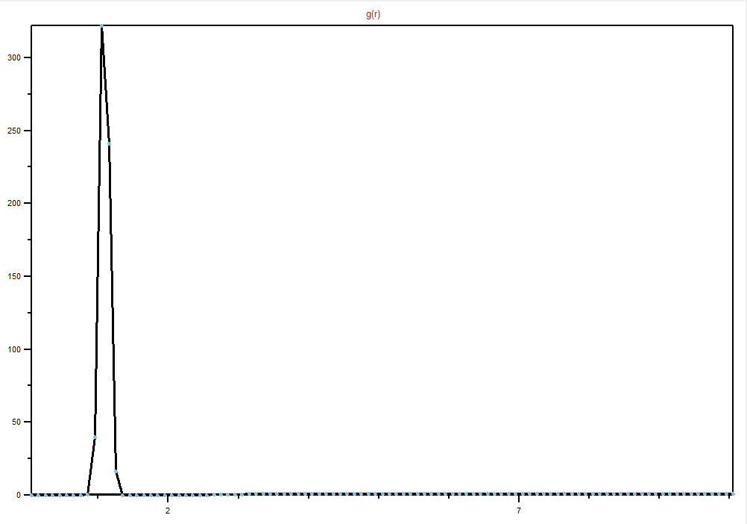
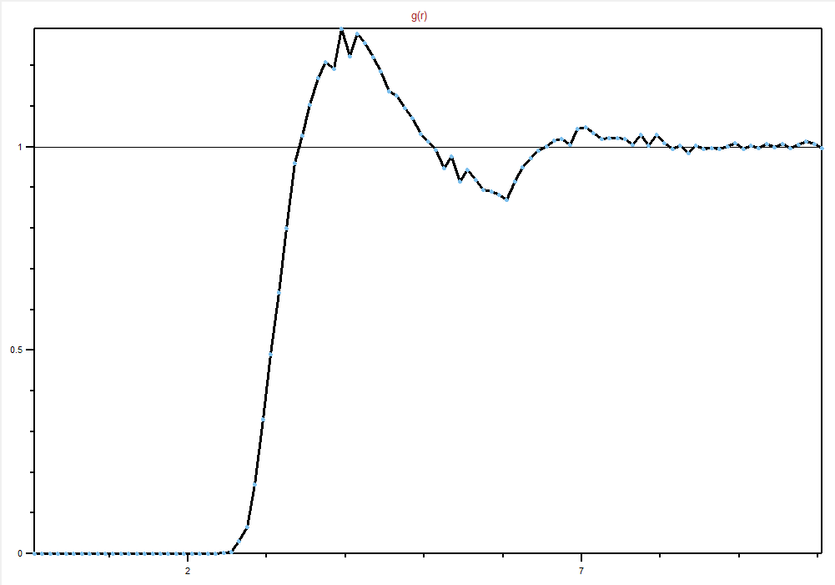
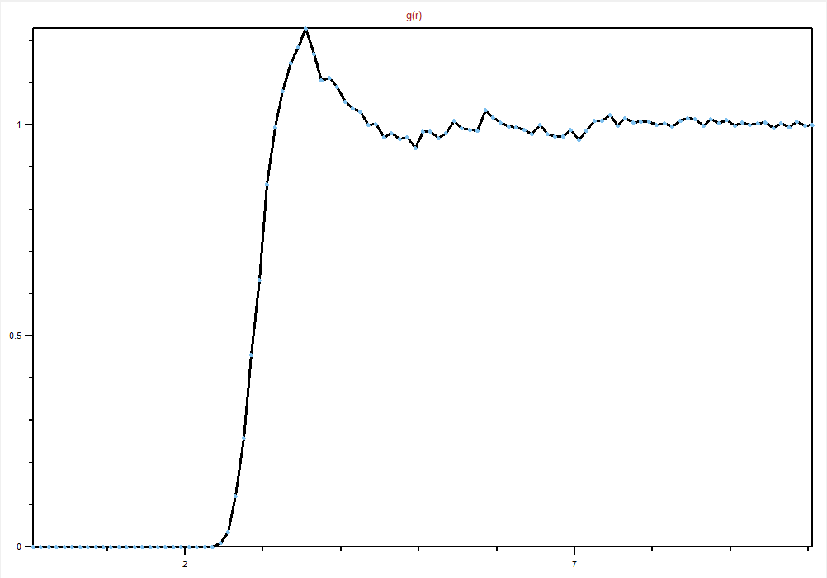
RDF calculation: VMD
Figure descriptions (clockwise starting from top left)
Figure 1: RDF C (sp3) – C (sp3)
Figure 2: RDF C (sp3) – H
Figure 3: RDF C (sp3) – O
Figure 4: RDF C (sp3) – C (sp)
Axis labels
X-axis: distance from reference atom in Å
Y-axis: value of g(r)

Slide 16
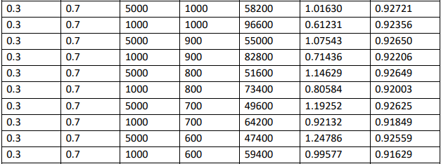
Density comparison: C++

Slide 17
Major findings
Density: Some of the simulated density values match with the expected density values. Some values are off by a small margin, and there are also some values which are significantly different from the calculated values
RDF: The RDFs of all the pairs of atoms even out (stop fluctuating) and assume the correct value of g(r) = 1 (for large distances), which shows that the system attains equilibrium
System size: We can see an apparent effect of the increase and decrease in simulation PT conditions on the system’s volume (simulation box)
Trajectory: CH₄ and CO₂ molecules don’t show any changes to their random trajectories, as seen from the simulations’ visualization

Slide 18
Discussion
Notes:
Discuss major findings -> explain errors

Slide 19
Major findings (cont.)
Randomness of trajectories: Observing the trajectories of CH₄ and CO₂ molecules for several different concentration values and PT conditions, we can see that while intermolecular forces may act within the system, they don’t affect the overall motion (randomness of the system)
Lack of clustering: There is no preferential clustering of molecules within the bounds of the system, i.e., the molecules are evenly spaced out within the simulation box. We can say that without using reactive parameters for accounting for changes within the system, both gases CH₄ and CO₂ are miscible even under high PT conditions

Slide 20
Erroneous data
Density comparison: We can see that some data closely matches the expected simulation results, while some others are off by a margin. This may be due to the difference in initial configurations of the system DATA files that have been used
Absence of reactive parameters: Some other factors which may account for these discrepancies may be tied to the assumptions we made while conducting this study, e.g., the absence of reactive parameters and/or force fields
Simulation box size: Finally, a larger simulation box may help with more accurate results for the last group of simulations, i.e., X_{CH4} = 0.1 (soft limit of simulation box volume was 125000 Å³)

Slide 21
Conclusions
Notes:
Restate research questions -> compare with results -> limitations -> future research

Slide 22
Conclusions
Miscibility: CH₄ and CO₂ do not show any immiscibility at high PT conditions; the movement of molecules of both gases are similar at the 2 different PT conditions used in each set of simulations
Clustering: The molecules of both gases do not show any layering or clustering, i.e., they are randomly distributed in space and do not seem to influence each other
Simulated data: Some of the simulations are successfully equilibrated, but the other simulations differ from the expected outcome

Slide 23
Limitations
Reactive parameters: No reaction force fields have been used to account for the formation of precipitate or other substances (if any) with the change in PT conditions
External forces: The simulation box created for this study does not account for external forces acting on the binary gas mixture (if any)
Simulation conditions: Simulations were conducted only for high PT conditions, and cases of high pressure, but low temperature weren’t considered. This makes the results of this study only valid for the gaseous state of CH₄ and CO₂

Slide 24
Future research
Reactive parameters: To improve upon the results of this study, further research can be done making the use of reactive force field (ReaxFF). This will help account for the formation of precipitate or any other substance in the system
External forces: Inclusion of external forces along the boundary of the simulation box may lead to results which more accurately reveal the interaction of CO₂ and CH₄ in nature, e.g., subsurface

Slide 25
References
Bakker, R.J. (1999) Adaptation of the Bowers and Helgeson (1983) equation of state to the H2O-CO2-CH4-N2-NaCl system. Chemical Geology 1999, 154, 225–236
Jorgensen, W.L., Maxwell, D.S., and Tirado-Rives, J. (1996) Development and Testing of the OPLS All-Atom Force Field on Conformational Energetics and Properties of Organic Liquids. J. Am. Chem. Soc. 1996, 118, 45, 11225–11236
Kiehl, J.T., and Trenberth, K.E. (1997) Earth’s Annual Global Mean Budget. Bulletin of the American Meteorological Society 1997,78, 2, 197-208

Slide 26
Thank You

